Slide 1


Managed Services The Easy Way
Wayne Small [SBS-MVP]
SBSfaq.com Pty Ltd
Notes:
“SMB Managed Services the easy way”
“Want to find out how to provide managed services to your customers without investing mega $$ in software? Come and see how you can with out of the box with solutions incorporating IBM Servers preloaded with SBS 2003 R2, along with TrendMicro CSM suite for SMB v3.5, and Netgear Infrastructure products. This presentation will include live demos on how to configure your clients servers to do all of the above.”

Slide 3
Our Goals
Discuss providing Managed Services to SMBs
Provide better solutions to our clients
Reduce cost to provide the solution
Use out of the box solutions
Integrated multiple vendors
Stretch your thinking

Slide 4
Who am I ?
Correct Solutions – Sydney based IT Reseller
  13 Staff
  10 yrs old
SBSfaq.com
  www.sbsfaq.com
  Trainer / Author / Community Advocate

Slide 5
Definition of Managed Services
What are Managed Services
Everyone is different!

Slide 6
Traditional Break/Fix
Based around hourly rates
Fixed $ profit per hour
How many hours in a week?
Reactive
Blocks of hours
Fixed price (based on hours)

Slide 7
Traditional Profit Model
$
Time
Examples courtesy of Kaseya ☺

Slide 8
Managed Services
Based on per device / user
Variable $ per device / user
Automation to reduce OUR time to do the work
Proactive
Less Stressful for YOU

Slide 9
Managed Services Profit Model
$
Time
Examples courtesy of Kaseya ☺

Slide 10
Step away from the hourly $
Clients want lowest rate / fastest response
Competitors focus on your rate not the outcome
Income stream is NOT predictable
If you do your job well you don’t get paid at all !!!

Slide 11
How to make it happen
Decide on a rate per user / device
Get an agreement in place
  Highlight what is covered
Lock the customers in place
Improve efficiency via automation
Reduce the time it takes you to provide the same services

Slide 12
What's included?
Basic monitoring
Backup and Recovery
Patch Management
Virus/Spyware control/response
Remote support
What else?

Slide 13
How to Structure the agreement
It’s up to you
Suggest you create multiple levels of agreement

Slide 14
Desktop SLA Examples
L1
L2
L3
Per-PC Cost
$10-$30
Patch Management
System Log Monitoring
Virus Protection
Daily System Audits
Monthly Reports
24 Hr Response
Per-PC Cost
$45-$75
Limited Help Desk
Application Deployment
Application /HW change
Security Log Monitoring
Spyware Removal
Bandwidth Usage
Asset Management
Remote Management
4 Hr Response
Per-PC Cost
$70 -$100
End User RC
Desktop Policy Enforcement
Unlimited Help Desk
Limited On-site
BU-DR
Weekly Reporting
2 Hr Rapid Response
Examples courtesy of Kaseya ☺

Slide 15
Server SLA Examples
L1
L2
Per-Server Cost
$195-$295
Patch Management
Remote Management
Event Log Monitoring
Backup Reporting
Hardware Changes
CPU Load
4 Hr Response
Per-Server Cost
$300 - $800
Exchange Monitoring
Security Log Monitoring
Application Deployment
Service Monitoring and Notification
Backup Reporting
SQL Monitoring
Disaster Recovery (DR)
1 Hr Rapid Response
Examples courtesy of Kaseya ☺

Slide 16
Benefits to the Client
Fixed monthly fee
Improved uptime, security
Service Level Agreement in place
Allows us to focus on strategic value rather than break/fix
Tell the client “I NOW get paid for doing a good job”

Slide 17
Pre-Packaged Solutions
Kaseya
Level Platforms
Hound Dog
All good solutions – but what can we do out of the box?

Slide 18
Other Options
SBS 2003 Monitoring and Reporting
IBM Director
Other low cost tools

Slide 19
Solution Requirements
Track key information on servers
Monitoring and alerting
Remote Access to systems
Integrate 3rd party products

Slide 20
Combining Products
Microsoft
  SBS 2003 R2
  OneNote
Trend Micro
  CSM v3.5 for SMB
IBM
  IBM x Series Servers
Netgear
  Managed Devices

Slide 21
Key Information on Servers
OneNote 2007
  Shared notebooks
  Create Templates for site information
  Replication of data
Custom Databases for larger organisations

Slide 22
SBS 2003 R2
New Features
  Update Services – Patch Management
  Improved licensing for 2nd Servers
Under utilised features
  SBS Backup – Disaster Recovery
  Monitoring and Reporting

Slide 23
Update Services
Email you daily with your patch status on your network
Show you the computers that are not being included in patching?
Auto approve some patches based on requirements?
Only download patches that are NEEDED

Slide 24
Update Services – How it works
WSUS 2.0 at the core
Additional GPO, tasks and wizards
Configure via SBS Console

Slide 25
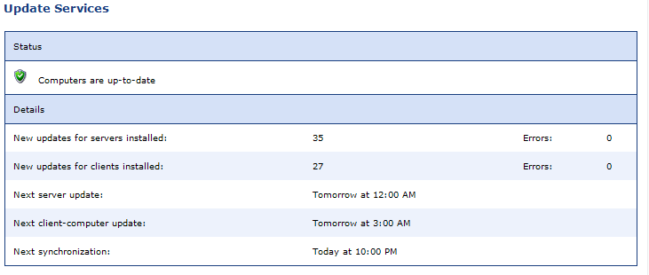
Update Services - Reporting

Slide 26
Update Services Demo

Slide 27
Update Services – Extending it
Non LAN based assets
Publishing WSUS
Extra computer groups

Slide 28
SBS Backup
Works well
  Captures email, AD, open files
Minimal recovery time
  Install CD1 then restore from tape
Can be sent alerts for backup success and failure
Attach backup logs to SBS Reports

Slide 29
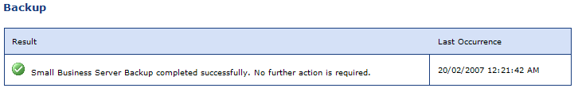
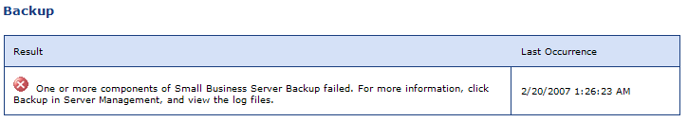
SBS Backup – Reporting

Slide 30
Monitoring and Reporting
Out of the box config is ok
Needs tuning to individual environments
Health Monitor @ the core
Extending Monitoring and Reporting
Custom Alerts
Monitoring other critical computers

Slide 31
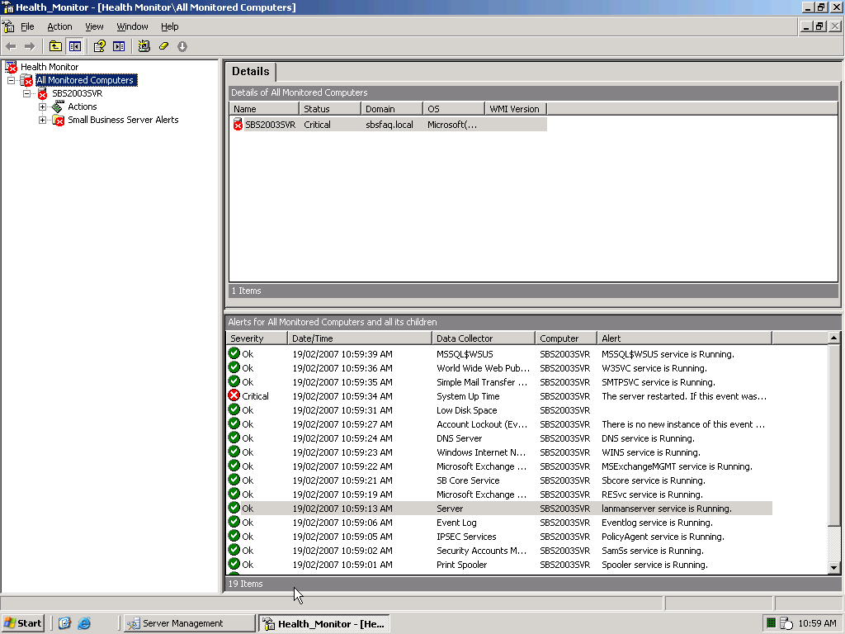
Health Monitor Screenshot

Slide 32
Modifying Alerts
Allocated Memory Alert
  Default is 2GB
Modify via the SBS Console

Slide 33
Adding info to alerts
Make the alerts more useful
Allows you to track what is “normal”
Done via Health Monitor

Slide 34
Custom Alerts - Backup
Allows more granular alerting
Successful Backup
  App Log
  Source: ntbackup
  Event ID 8019
  Info Event

Slide 35
Custom Alerts - Security
Failed Login Attempts
  Security Log
  Source: Security
  Event ID 529
  Critical Event

Slide 36
Additional Event Logs
Can be created by script
Used for logging whatever you want via script
Additional logs will appear in SBS Reports

Slide 37
Additional Computers
Healthmon can be installed on other computers
  CD3
  Healthmon21 Directory
  Install Agent only
Configure alerts and functions individually

Slide 38
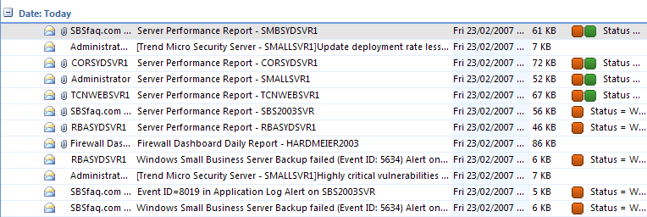
Outlook Rules

Slide 39
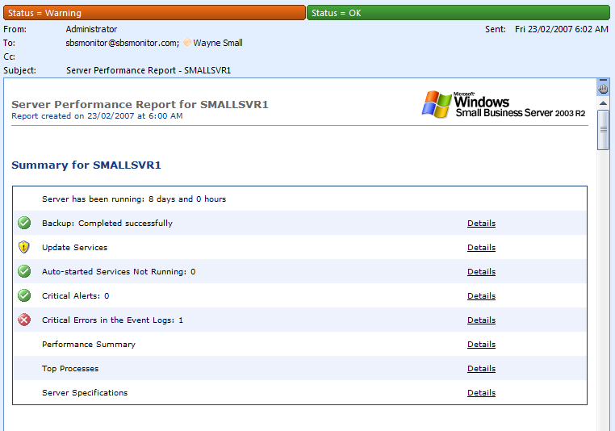
Outlook Rules

Slide 40
Monitoring and Reporting Demo

Slide 41
SBS + Vista = Can be done.
Ripcurl Patch – aka KB 926505
Enables Vista to be added the SBS way
Works on SBS 2003 SP1 and SBS 2003 R2
  http://support.microsoft.com/kb/926505/en-us

Slide 42
Trend Micro
Used to provide protection to my clients
  Antivirus
  Antispyware
  Antispam
Reporting on success !

Slide 43
CSM 3.5 New Features
Features | CS | CSM
Anti-Threats (spyware, rootkits, bots)
Spyware deep referential cleaning- New! | ✓ | ✓
Rootkit detection and removal- New! | ✓ | ✓
Bot protection- New! | ✓ | ✓
Anti-spam (server-side, new engine)
Server-side spam quarantine- New! | n/a | ✓
Enhanced heuristic anti-spam filtering- New! | n/a | ✓
Increased speed of signature updates- New! | n/a | ✓
Miscellaneous
Client update source- New! | ✓ | ✓
Generic clean functionality- New! | ✓ | ✓

Slide 44
Upgrades..
CSM 3.0 Key code works
Inplace from 3.0 to 3.5 = fine
Inplace from 2.0 to 3.5 = fine
OEM v2.0 may have some issues

Slide 45
Features we use
Antivirus/Antispyware
Antispam
  Client side management
Vulnerability Assessment
  Cross check against SBS Update Services

Slide 46
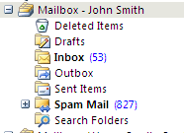
Antispam Example
John Smith = Honeypot
No real email
95% SPAM
Client Managed
Alerts if too high

Slide 47
Extending it for Managed Services
Notifications
Logging to event logs
SNMP Traps

Slide 48
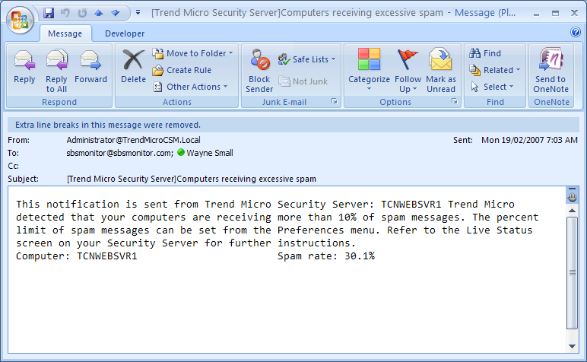
SPAM too high

Slide 49
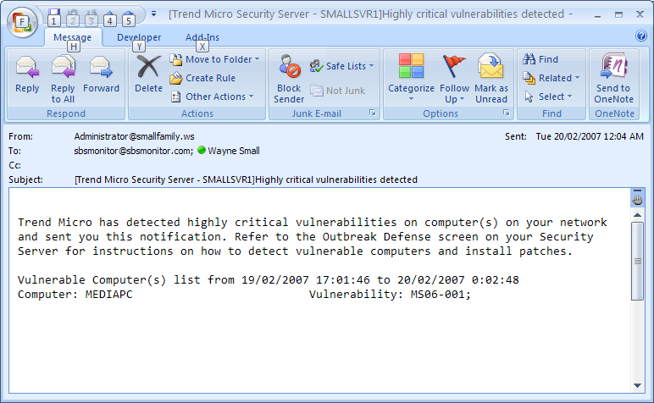
Vulnerability Scanning

Slide 50
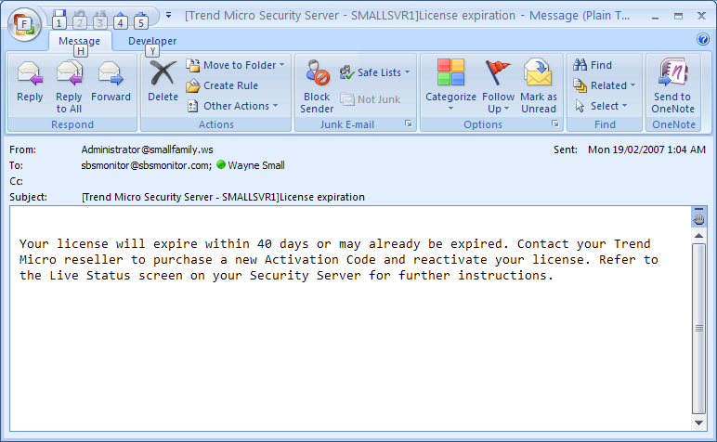
License Expiration

Slide 51
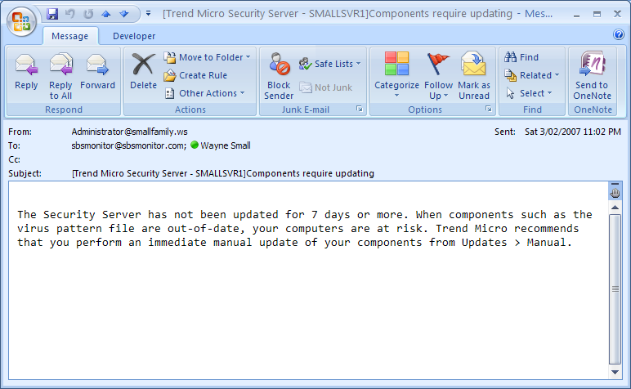
Update not occurring

Slide 52
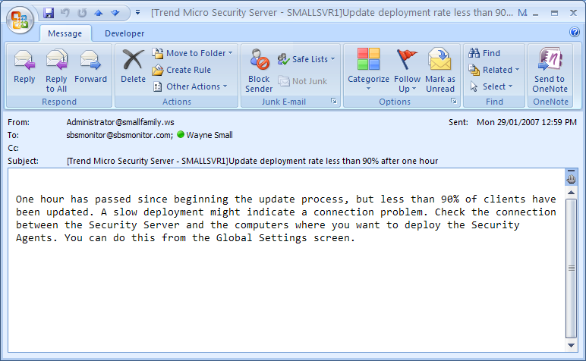
Update too slow

Slide 53
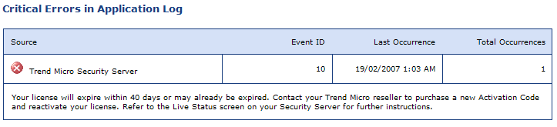
Errors in event logs

Slide 54
CSM v3.5 Demo

Slide 55
IBM Hardware Value
It’s a given – Tier 1 vendor
Lightpath Diagnostics
  End user can help with diagnosis

Slide 56
IBM Director
Find and identify systems on the network
Determine if systems are working properly
Configure and deploy new systems
Optimize systems for peak performance
Keep system firmware and drivers up to date

Slide 57
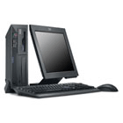


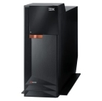
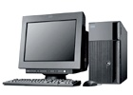

IBM Director Architecture
IBM Director Server
Application Logic
Database
Management
Console(s)
Java GUI
IBM Director Agent
Managed Systems
(Servers, Desktops, Laptops, SNMP devices, CIM devices)

Slide 58
What can Director manage
IBM Systems
System x, System p, System i, System z, BladeCenter
HP, Dell, and other Intel-compatible servers
SNMP-based devices
Network, storage, power distribution units, etc.
CIM-based devices
CIM = Common Information Model
Personal computers
Retail Store Systems (Point of Sale)
Selected storage
DS4000, ServeRAID – expanding to more
SMIS-compatible devices

Slide 59













From Deployment Through Maintenance …
Deploy
$
Maintain
Remote Deployment
Manager $
Monitor & Alert
Hardware Status
SW Distribution
Open
Event Action Plans
Update Assistant
Inventory
Easy to Use
Integrated
Scheduler
Resource Monitor
Virtualization Manager
Remote Control
Capacity Manager $
PowerExecutive
Analyze &
Troubleshoot
System Availability
Dynamic
System Analysis
Optimize

Slide 60
IBM Director ‘Tiered’ Agent
Level 0 = “Agentless Management”
  Discovery, login, Attributes, Power Control, base Inventory, Remote Session (Linux)
  Promotion to Level 1 or Level 2 through Software Distribution
Level 1 = “Core Services”
  Level 0 + Event Log, Event Action Plans, Hardware Status, platform specific Inventory, Director Update Assistant, Upward Integration
  Promotion to Level 2 through Software Distribution
Level 2 = “IBM Director Agent”
  Level 1 + all remaining "for free" tasks

Slide 61
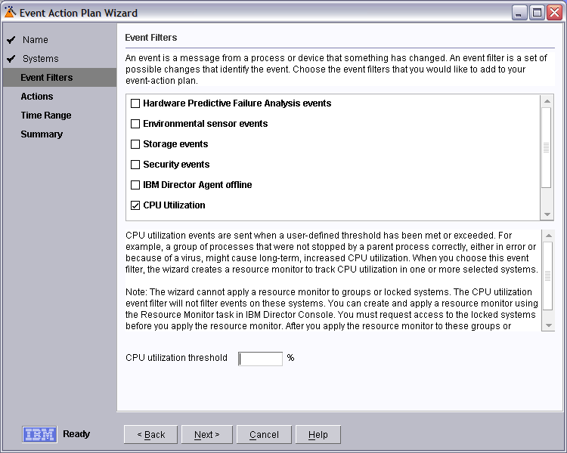
Event Action Plan Wizard
Simplifies the process of creating an event action plan and applying it to a group or system
Starts integration monitor thresholds (like CPU Utilization) into a streamlined wizard
Used to create and later modify Event Action Plans built with Wizard

Slide 62
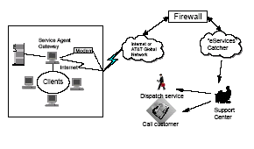
Electronic Service Agent
Electronic Service Agent as Stand alone or via IBM Director
Automatically calls home and logs service call to IBM in event of PFA detected, safely and securely
IBM Mainframe, AS400 and RS6000 inspired technology and reliability
V4 is BladeCenter ready
Monitors ServeRAID and Service processors.
Proactive replacement for maximum uptime.

Slide 63
Capacity Manager
Capacity Manager monitors server resource utilization and identifies bottlenecks
Predicts future bottlenecks and recommends how to avoid them
Generates performance analysis reports
Companies average 4.4 server performance incidents per month. Each incident requires 3.5 hrs of IT staff time to fix! ¹
Help optimize system performance and availability
Get advance warning and avoid costly unplanned outages
Help justify system upgrades

Slide 64
IBM Director – Licensing
Base Director server
  Up to 20 agents without additional $
  More added – around $40 per agent

Slide 65
IBM Director
Install Director Server on the SBS server itself
Install Director Agent on all remote computers
Need to have a service account on the Director Server itself

Slide 66
IBM Director Demo

Slide 67
Netgear
Managed Switch
Firewall/routers
SSL VPN Appliance
SNMP
Syslog
Email Alerts

Slide 68
Netgear Managed Switch
GSM and FSM devices
Layer 2 Smart – Entry level
Layer 2 & Layer 3
VLAN capabilities
Remote Web Management
SNMP capable

Slide 69
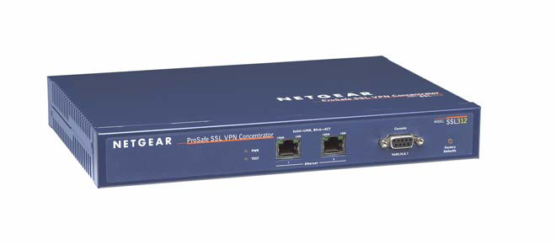
Netgear SSL 312
No client software or config required
Allows up to 25 remote users
Web based access
Port level filtering

Slide 70
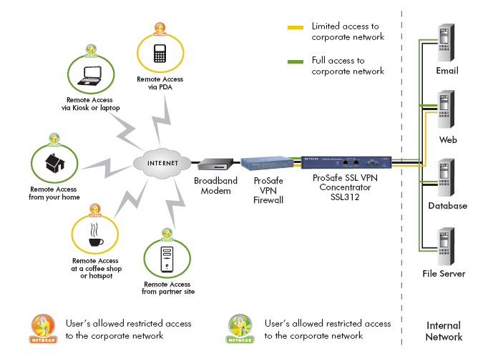
Network Overview

Slide 71
Netgear SSL VPN Demo

Slide 72
Summary
It IS possible to provide managed services WITHOUT huge $$ investment
Gives you a chance to “get into the game”
Allows you to build a more profitable business ☺
Allows you to be LESS stressed ☺

Slide 73
Resources
MS Res Kit Tools
  http://support.microsoft.com/kb/927229
Network Monitoring Tools
  http://www.slac.stanford.edu/xorg/nmtf/nmtf-tools.html
SNMP Monitoring Info
  http://www.wtcs.org/snmp4tpc/
  http://www.snmp-informant.com/
Kiwi Syslog Monitor
  http://www.kiwisyslog.com/links.htm

Slide 74
Resources
Business Level
  SMBManagedServices – Yahoogroup
  SmallbizIT - Yahoogroup
Technical
  SBS2k – Yahoogroup

Slide 75
Resources
SBS Usergroups
  www.sbsgroups.com.au
Local Group = Brisbane
  Last Tuesday of each month – 5:30pm
  Microsoft
Next Meeting – March 27th

Slide 76
Announcing...
Australia’s first SMB Reseller Conference
  November 23/24 2007
  Sydney, Australia
Please give me a business card for more information!

Slide 77
Questions & Thank You!
Wayne Small [SBS-MVP]
SBSfaq.com Pty Ltd
wayne@sbsfaq.com

